Slide 1
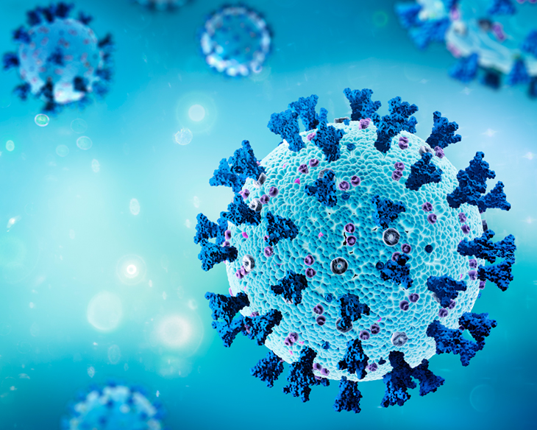

COVID-19 Detection using Transfer Learning-Based CNN Models
SUPERVISOR – DR. OGERTA ELEZAJ
UMESH MEHTRE (21133500)

Slide 2
Contents
Introduction
Literature Review
Methodology
Results
Conclusion

Slide 3
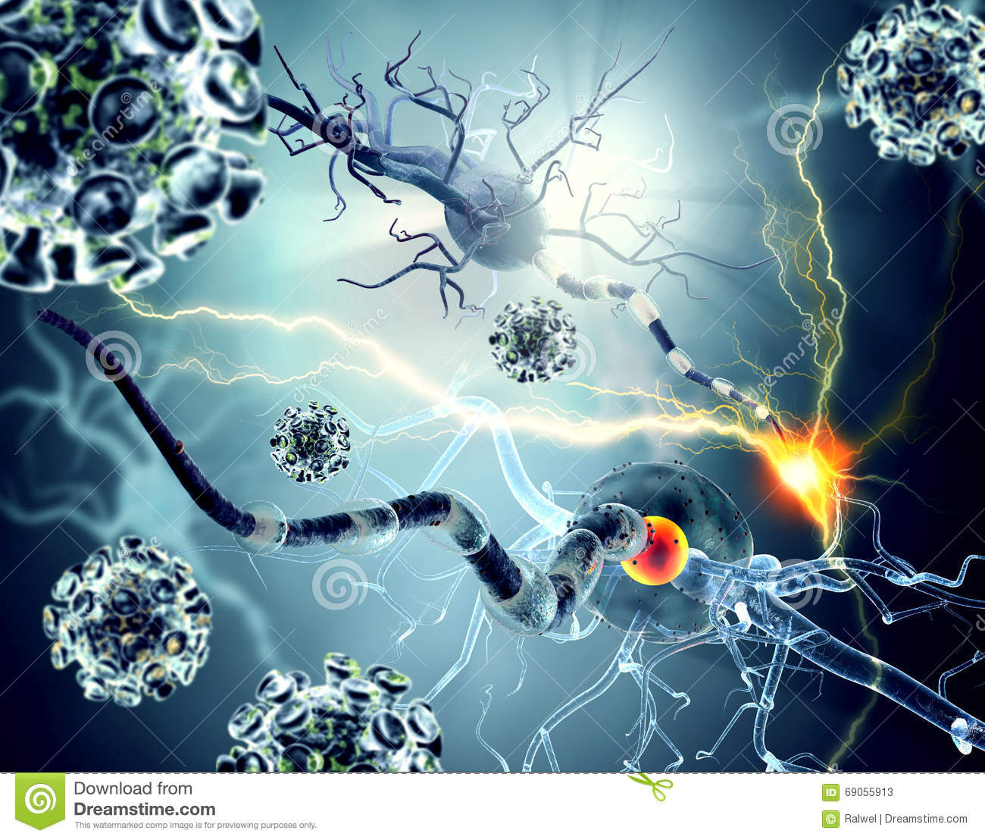
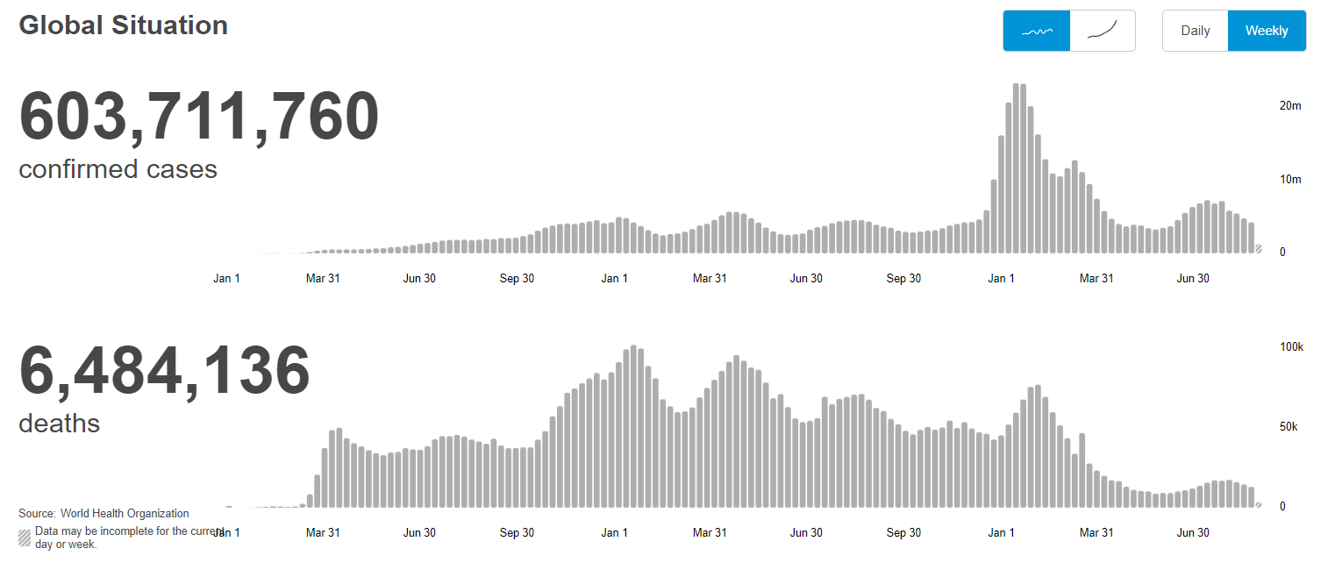
Introduction
Covid-19 is an infectious disease, that started in Wuhan, China, spread rapidly among other countries, and approached approximately 603 million and 6.46 million deaths(according to the statistics of WHO.)
RT-PCR (Real-time polymerase chain reaction) is the approach that has proven to be the most successful in identifying novel coronaviruses (COVID-19), but it is quite expensive and time taking.
Therefore, Radiological imaging techniques, such as chest X-rays, have been proven to be effective. This is because X-ray technology is frequently available in most hospitals. Several radiological signals detected by COVID-19 are easily identified using chest X-rays as a diagnostic tool.
This study proposes three separate pre-trained convolutional neural network-based models (ResNet50, VGG19, and InceptionResNetV2) for detecting Covid and Normal using chest X-ray radiography images. When the performance results are examined, it is clear that the pre-trained Inceptionresnetv2 model provides the best classification performance and VGG19.

Slide 4
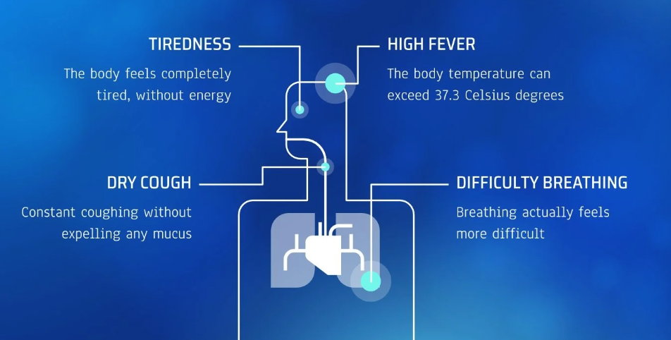
SYMPTOMS OF COVID-19:

Slide 5
Objectives:
Does balancing data through data augmentation improve the generality of transfer learning methods for COVID classification?
What are the effects of different data augmentation strategies on the performance of transfer learning methods in COVID detection?

Slide 6
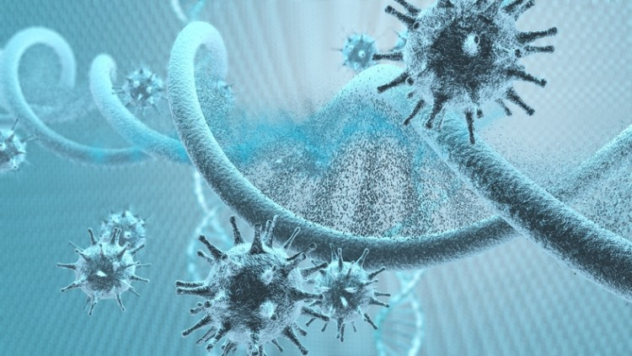
Literature Review
Work done by other researchers
Work done by other authors
Dataset | Model | Accuracy
Covid – 4045 Normal – 5500 Training - 7636 Testing – 1909 Elpeltagy et .[1] | ResNet-50 | 97.1%
Covid – 3616 Normal – 10193 Training - 11047 Testing – 2761 Badrahadipura et al.[3] | InceptionresnetV2 | 96.6%
Covid – 3500 Normal – 3500 Training - 4900 Testing – 2100 Mangalmurti et al. [2] | VGG19 | 98.6%

Slide 7
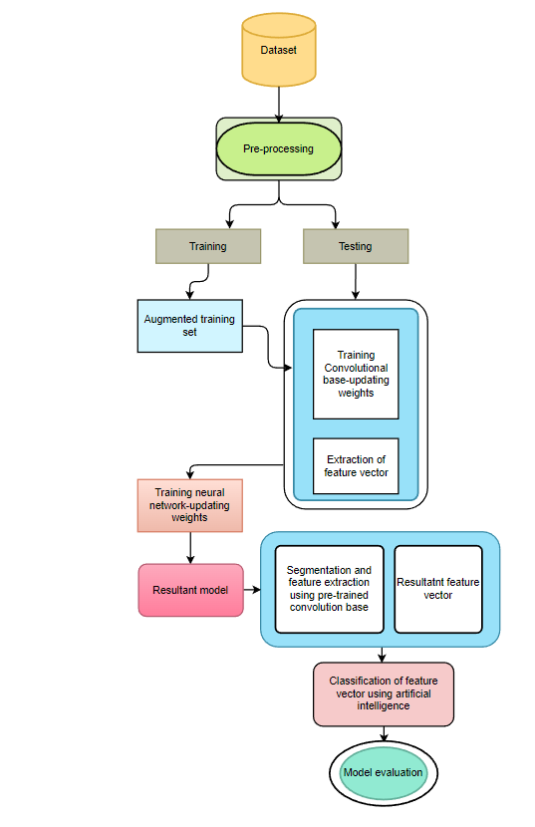
Methodology
In this study, we carried out three different experiments with an unbalanced and balanced dataset with a deep convolutional neural network (CNN) built which was based on ResNet50, VGG19, and Inception-ResNetV2 models for the classification of COVID-19 Chest X-ray images to Normal and COVID-19 classes.
In addition, experiments were conducted using transfer learning with ImageNet data and different loss functions (Binary-cross entropy, Focal loss) to overcome insufficient data and training time.
Flowchart of the model

Slide 8
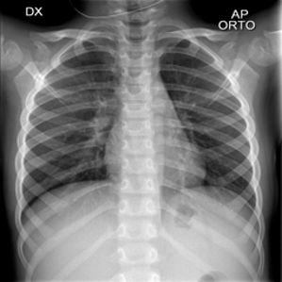
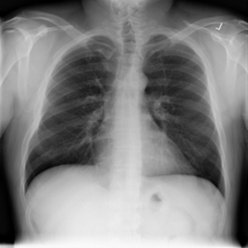
Dataset
This Dataset was generated by the author [4][5]. In this study, we have used the 3616 Covid-19 (+) and 10192 Normal images.
We have split the dataset into 80:20 for training and testing.
The images are grayscale and 224x224 in size.
Representative chest X-ray images of Covid and Normal

Slide 9

To overcome the imbalanced data we used binary-cross entropy and focal loss.
What is binary-cross entropy?
What is focal loss?

Slide 10

Experimental setup
The Python programming language was utilized to train the proposed deep transfer learning models. All experiments were carried out using a Google Collaboratory system running 64-bit Windows 10, an Intel i5-9300HF CPU running at 2.4 GHz, and 8GB of RAM. The Adam optimizer was used to pre-train CNN models (ResNet50, VGG19, and Inception-ResNetV2) with initialization weights. For all experiments, the batch size, learning rate, and the number of epochs were set to 32, 0.0001, and 10, respectively. The dataset was divided into 80% for training and 20% for testing.

Slide 11
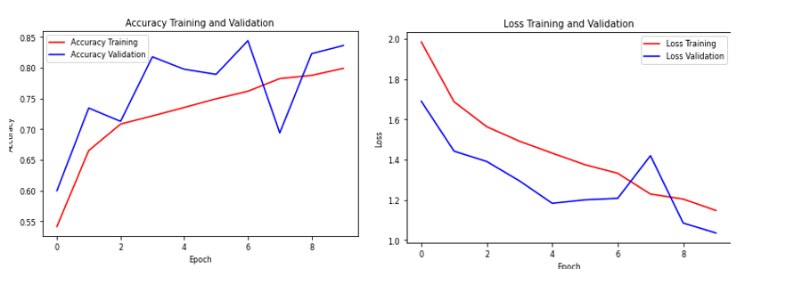
Results:
Experiment 1
This experiment was done with the balanced dataset and applied to the vgg19 model.
This experiment was carried out with a balanced dataset with 3616 Covid and 3616 Normal chest X-ray images.
All the images are set to 224x244 pixel size with learning rate = 0.001, batch size =32, and number of epochs=10 with Adam optimizer
This model’s accuracy is 98.7%

Slide 12
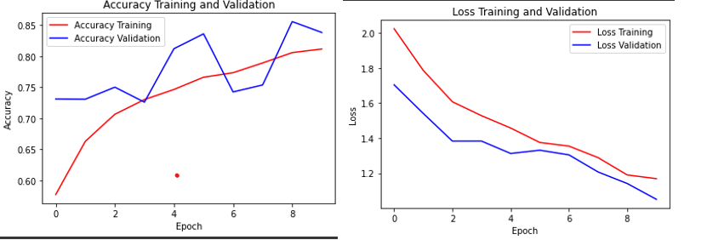
Experiment 2
This experiment was done with the unbalanced dataset and applied to the InceptionresnetV2 model.
This experiment was carried out with a balanced dataset with 3616 Covid and 10192 Normal chest X-ray images.
All the images are set to 224x244 pixel size with learning rate = 0.001, batch size =32, and number of epochs=10 with Adam optimizer
This model’s accuracy is 99.52%

Slide 13
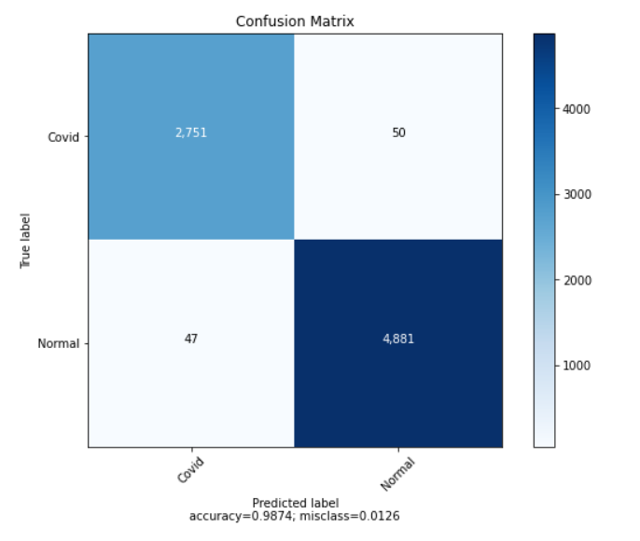
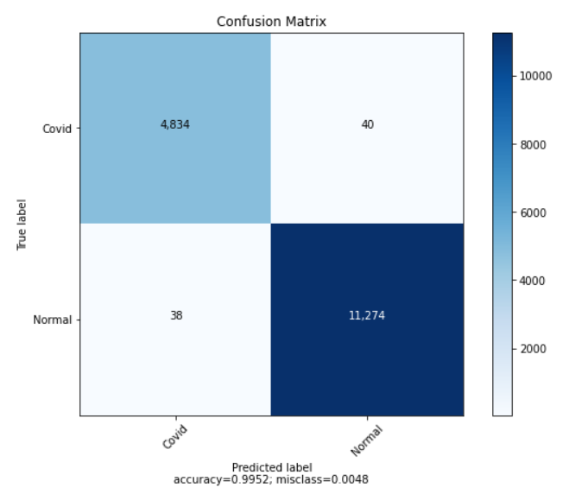
Confusion Matrix
VGG19 model classified 2751 of the COVID-19 as True Positive and classified 4881 of the Normal as True Negative.
Inception ResNetV2 classified 4834 of the COVID-19 as True Positive and classified 11274 of the Normal as True Negative.

Slide 14
Prediction performance results were obtained from two pre-trained models.
Models | Accuracy | Recall | Specificity | Precision | f1-score
VGG19 | 0.9874 | 0.9832 | 0.9899 | 0.9821 | 0.9827
InceptionResnetV2 | 0.9952 | 0.9922 | 0.9965 | 0.9918 | 0.9920
Obtained Accuracy using whole dataset |  |  | Work done by other authors using same dataset
Dataset | Model | Accuracy | Dataset | Model | Accuracy
Covid – 3616 Normal – 10193 Training - 11047 Testing – 2761 | ResNet-50 | 97.33% | Covid – 4045 Normal – 5500 Training - 7636 Testing – 1909 [Elpeltagy et .[1]] | ResNet-50 | 97.1%
Covid – 3616 Normal – 10193 Training - 11047 Testing - 2761 | InceptionresnetV2 | 99.52% | Covid – 3616 Normal – 10193 Training - 11047 Testing – 2761 Badrahadipura et al.[3]] | InceptionresnetV2 | 96.6%
Covid – 3616 Normal – 10193 Training - 11047 Testing - 2761 | VGG19 | 95.37% | Covid – 3500 Normal – 3500 Training - 4900 Testing – 2100 [Mangalmurti et al. [2]] | VGG19 | 98.6%

Slide 15
Conclusion
Early detection of COVID-19 patients is critical to preventing the disease from spreading to others. In this article, we suggested a deep transfer learning-based approach for automatically predicting COVID-19 patients utilizing chest X-ray pictures taken from COVID-19 patients and normal. The InceptionresnetV2 pre-trained model outperformed the other two models with the highest accuracy of 99.52%. Because of the strong performance, it is expected that our findings would aid clinicians in making clinical judgments. This paper explains how deep transfer learning algorithms can be utilized to detect COVID-19 at an early stage. The classification performance of different pre-trained models can be examined in subsequent research by increasing the number of images in the dataset.

Slide 16
References:
Elpeltagy, M., & Sallam, H. (2021). Automatic prediction of COVID− 19 from chest images using modified ResNet50. Multimedia Tools And Applications. https://doi.org/10.1007/s11042-021-10783-6
Mangalmurti, Y., & Wattanapongsakorn, N. (2021). COVID-19 and Other Lung Disease Detection Using VGG19 Pretrained Features and Support Vector Machine. 2021 25Th International Computer Science And Engineering Conference (ICSEC). https://doi.org/10.1109/icsec53205.2021.9684594
Badrahadipura, R., Nur Septi, S., Fachrel, J., Yulita, I., Pravitasari, A., & Agustian, D. (2021). COVID-19 Detection In Chest X-Rays Using Inception Resnet-v2. 2021 International Conference On Artificial Intelligence And Big Data Analytics. https://doi.org/10.1109/icaibda53487.2021.9689723
M.E.H. Chowdhury, T. Rahman, A. Khandakar, R. Mazhar, M.A. Kadir, Z.B. Mahbub, K.R. Islam, M.S. Khan, A. Iqbal, N. Al-Emadi, M.B.I. Reaz, M. T. Islam, “Can AI help in screening Viral and COVID-19 pneumonia?” IEEE Access, Vol. 8, 2020, pp. 132665 - 132676. [CrossRef]
Rahman, T., Khandakar, A., Qiblawey, Y., Tahir, A., Kiranyaz, S., & Abul Kashem, S. et al. (2021). Exploring the effect of image enhancement techniques on COVID-19 detection using chest X-ray images. Computers In Biology And Medicine, 132, 104319. https://doi.org/10.1016/j.compbiomed.2021.104319

Slide 17
Thank you

